Slide 1
SOEs and their role in the economy of BRICS member countries
ONGC Videsh:
Pioneering India’s energy security overseas
Narendra K Verma
Managing Director and CEO
ONGC Videsh Limited
November 18, 2016

Slide 2
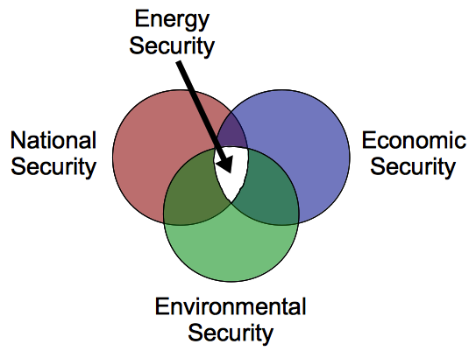
Elements of Energy paradigm
Geopolitics as key driver

Slide 3
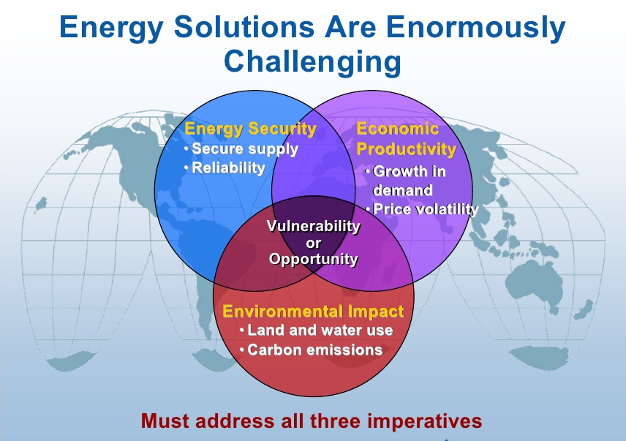
Complexity of Energy supplies

Slide 4
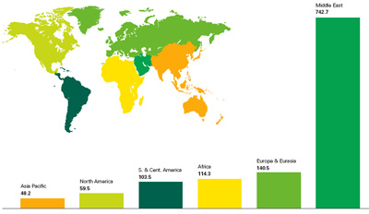
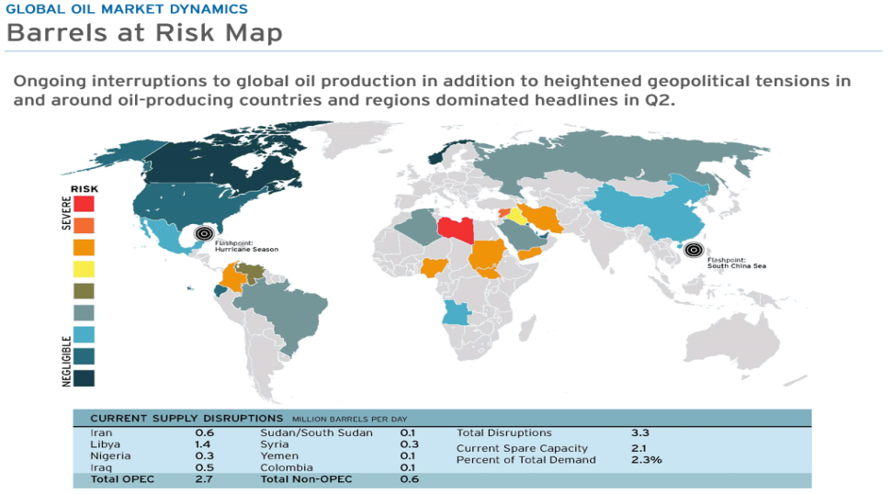
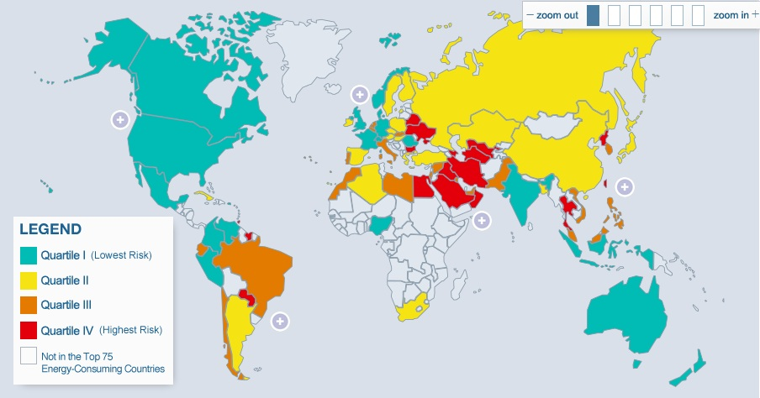
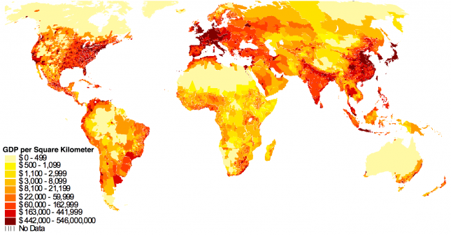
Complexity of Energy supplies
Resources
Production Risk
Demand
GDP Growth

Slide 5
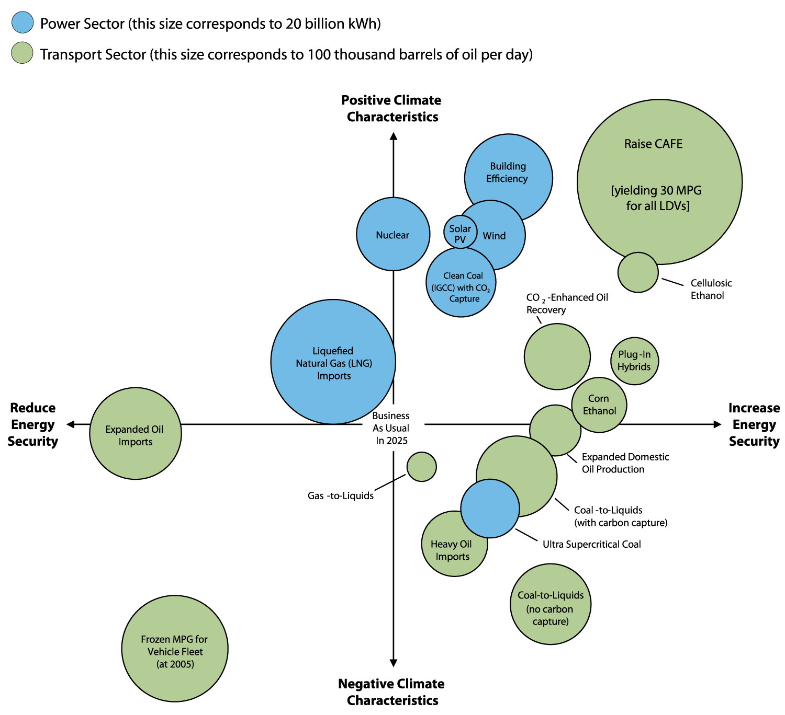
Energy Security & Environmental Impact

Slide 6
Energy Security… a priority for all
A Global shared vison inherently acknowledges that
  the core of energy security lies in the acceptance of the fact that there is only one oil market
    a complex and worldwide system that moves and consumes about 90 million barrels of oil every day.
  For all consumers and all producers , energy security resides in the stability, cooperation and mutual complementarity of this market
Producers
  seek a fair and stable economic exchange for their resources that they so painstakingly produce
Consumers
  strive to provide the means for aspirational and increasingly energy-hungry populaces to achieve higher standards of living
State Owned Enterprises (SOEs) are critical instruments of state policy
  By which countries protect and secure their energy needs
  Both as producers or consumers

Slide 7
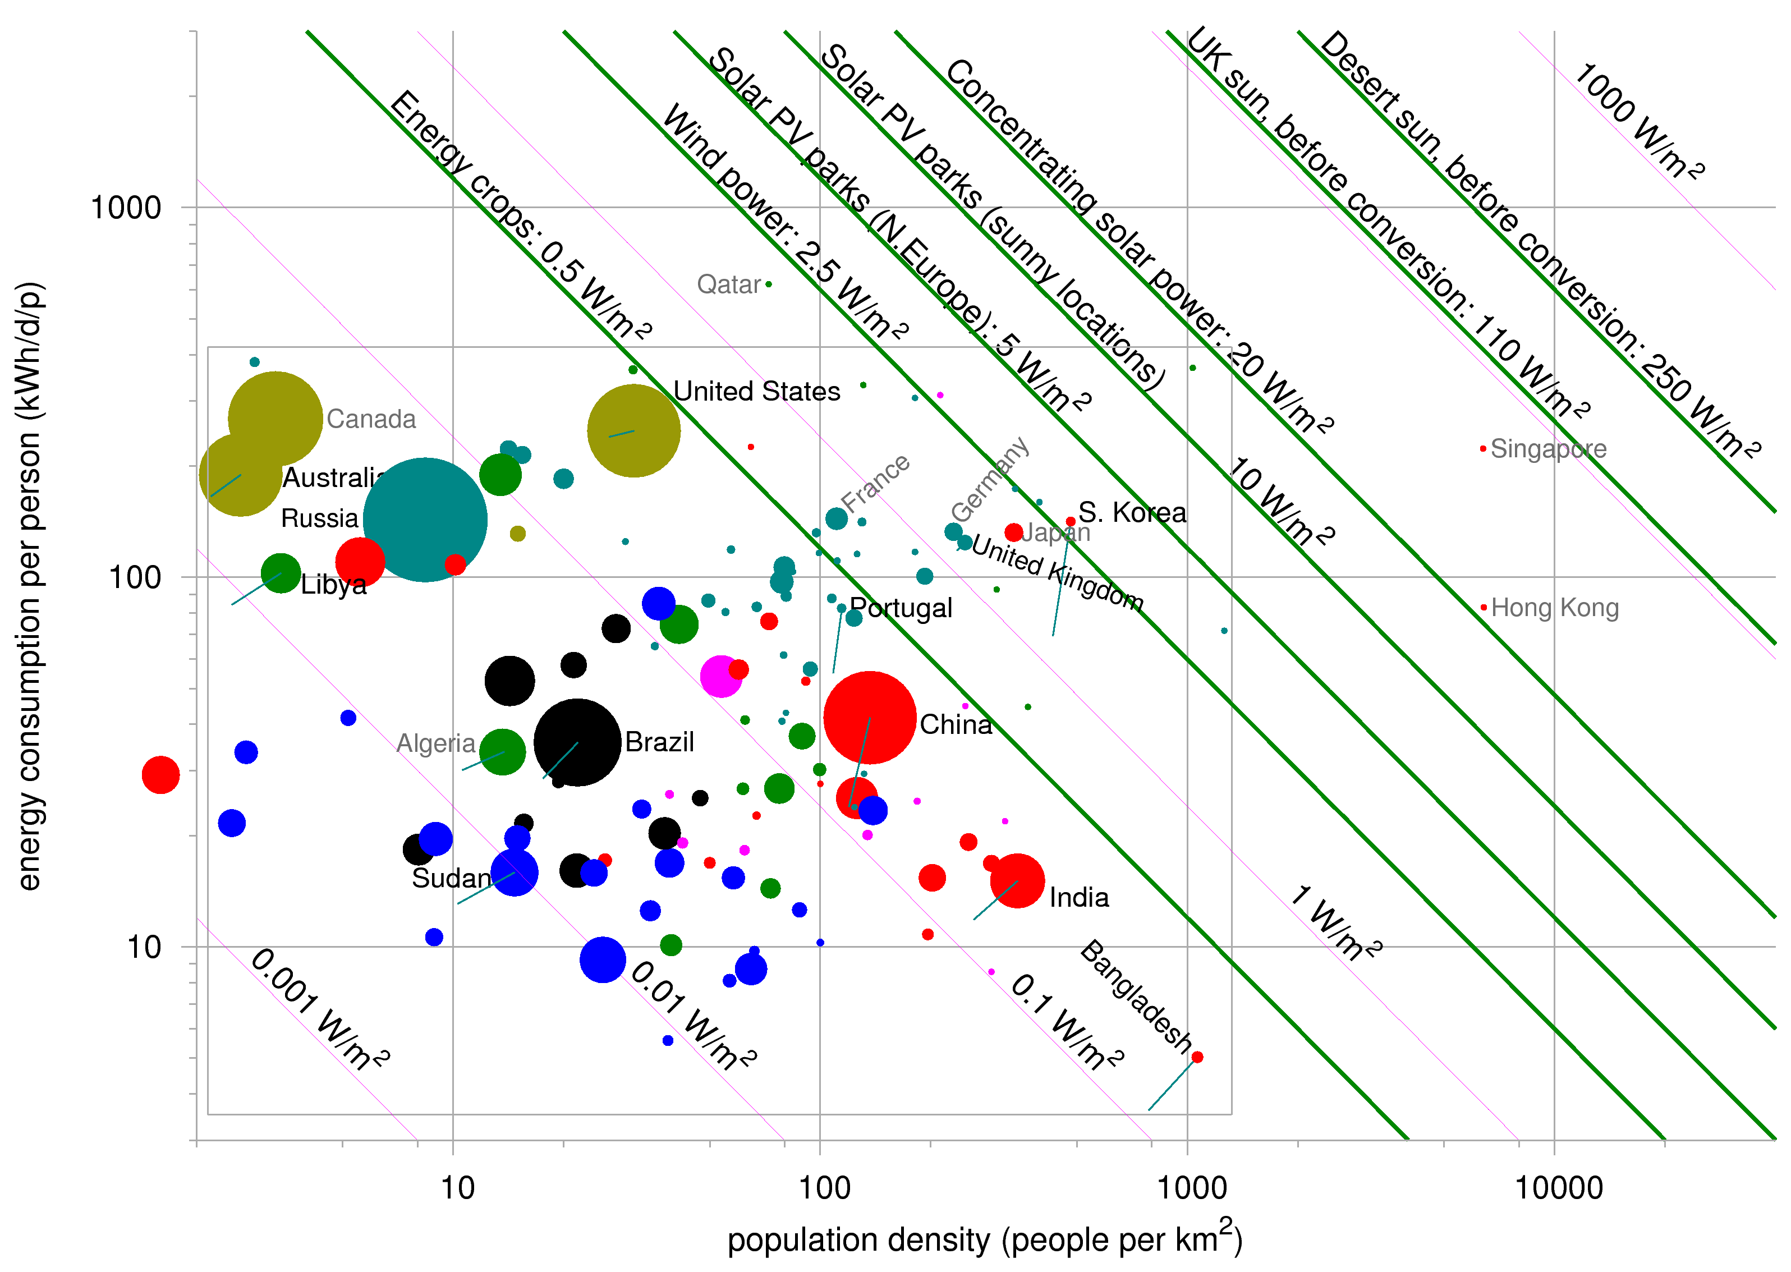
Global Energy Density
India

Slide 8
India’s need for energy security
A growing GDP and an unquenchable thirst for energy…..
Source: Exxon Mobil

Slide 9
India’s per capita production amongst the lowest among BRICs…..
IEA India Energy Outlook 2015 says……….
Fossil fuels supply around three-quarters of India’s primary energy demand
This share will tend to increase over time as households move away from the traditional use of biomass
This high – and potentially growing – reliance on fossil fuels comes with two major drawbacks.
  India’s domestic production of fossil fuels, considered on a per-capita basis, is by far the lowest among the major emerging economies
  meaning that India has a structural dependence on imported supply.

Slide 11
India’s import bill over the years……

Slide 12
Summing up……India’s need for Energy Security
India’s petroleum import bill has increased
      Gross petroleum imports stand at record level of 231 MMT in FY16
      ephemeral nature of oil price cyclicality is historically proven, hence potential for future shocks
India is projected to contribute more than any other country to the projected rise in global energy demand
  propelled higher by an economy that is projected to be ~ five times larger in 2040 and
  a demographic expansion that makes India the world’s most populous country
Significant Oil and Gas supplies have to be sourced from overseas
Acquisition of prolific natural resources overseas is a continued imperative
State Owned Enterprises have a significant role to play in securing energy resources overseas

Slide 13
  ONGC Videsh: pioneering energy security

Slide 14
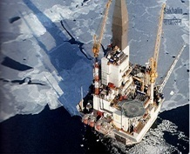
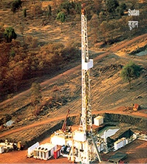
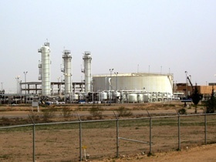
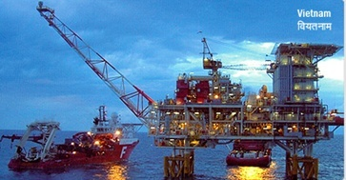
ONGC Videsh Ltd.
Securing India’s Energy needs overseas
Wholly-owned subsidiary of ONGC, engaged in international E&P business
Incorporated as Hydrocarbons India Pvt. Ltd. | March 5, 1965
Rechristened ONGC Videsh Ltd | June 15, 1989
Oil and Gas Assets | 37
Global Presence | 17 Countries
Production (FY 2015-16) | 166,000 BOEPD
Production (Sep 2016) | 231,493 BOEPD
2P/3P reserves | 596/ 633 MMTOE (as on 01.04.2016, excl. Vankor reserves)
Cumulative Investment (ITD Sept 2016) | US$ 26.256 Billion

Slide 15
The Growth Story……
Imagine a company at the turn of the millennium
  A modest 0.25 mmt of global production
  One project: in the South East Asian neighborhood
  A cumulative plan expenditure of US$0.58 Bn
And now in circa 2016, in a decade and a half
  37 projects in 17 countries: a truly global footprint
  Annual production of 8.92 mmt in FY’16
  Cumulative investment of US$26.26 Bn
  A reserve base of 633 mmtoe
    94.5% of reserves in P1 & P2 Category
The Growth of ONGC Videsh, India’s flagship energy multinational, is story of the growth of India’s overseas energy acquisitions
  A story is of unprecedented growth
    a global footprint of assets spread across the globe and spanning continents

Slide 16
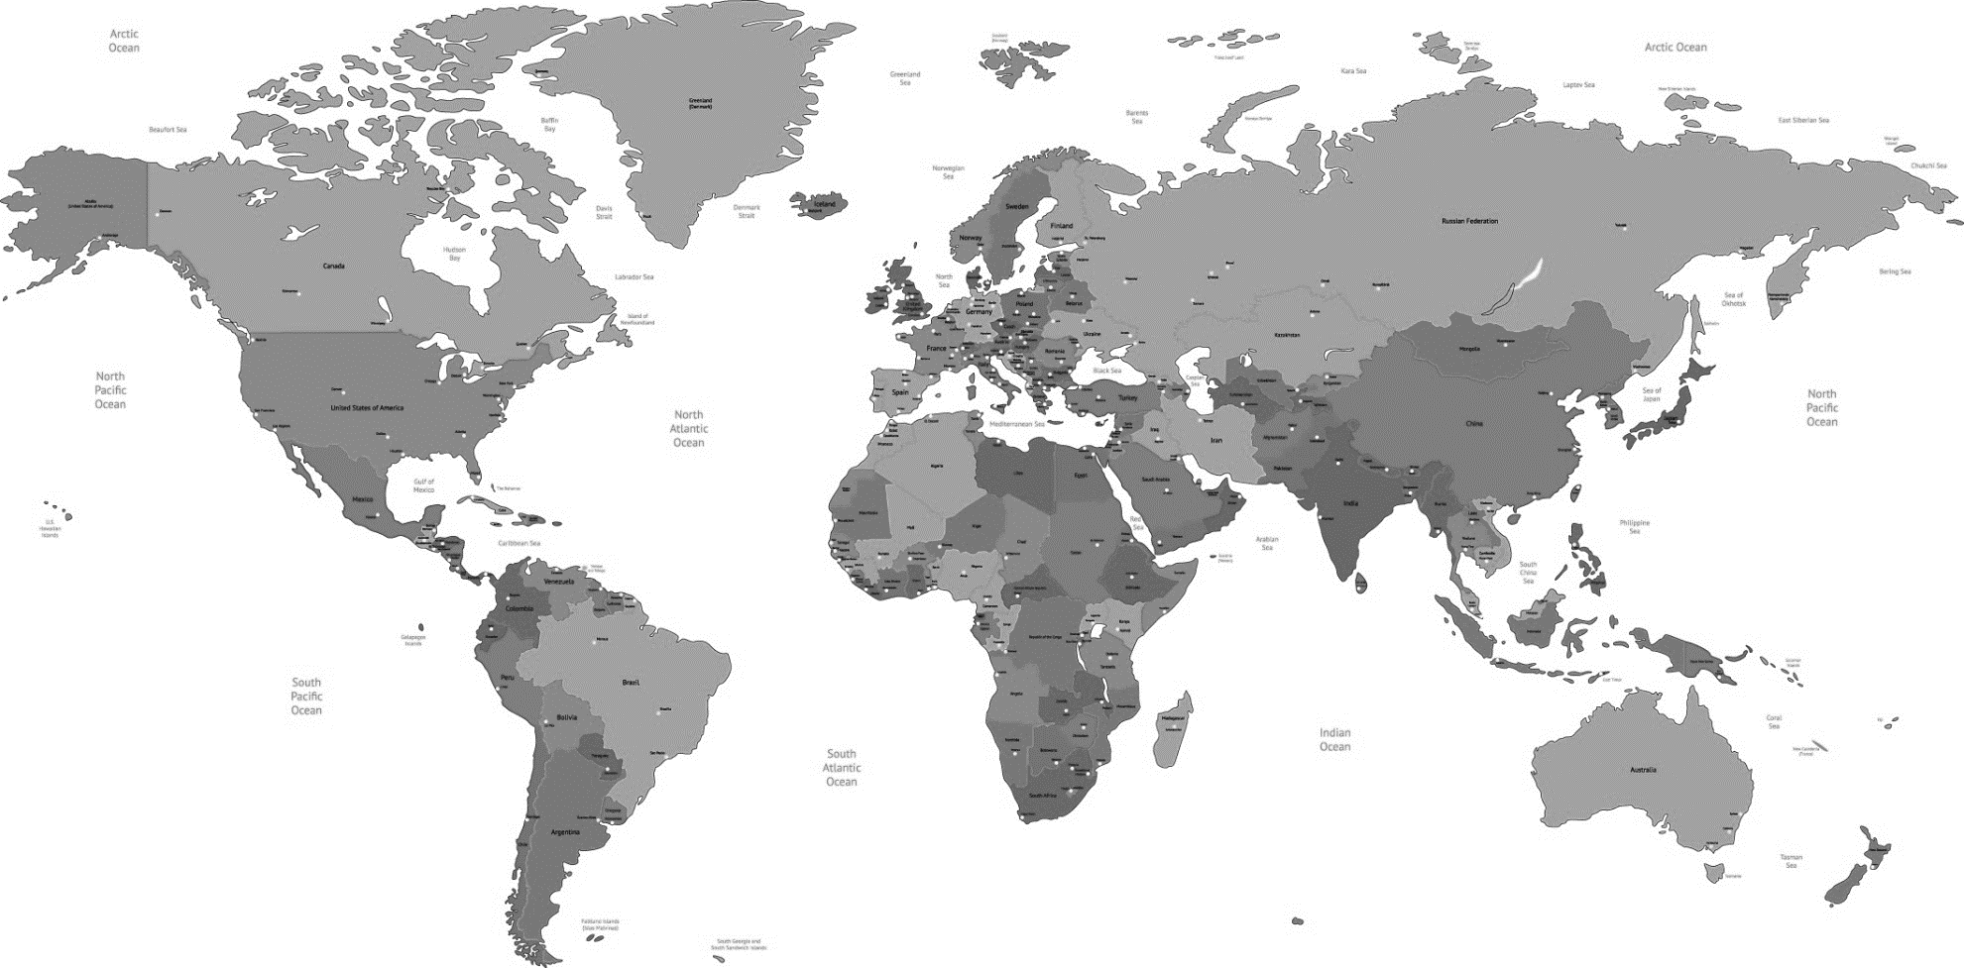
ONGC Videsh: The Present Global footprint
Russia
Azerbaijan
Kazakhstan
Syria
Libya
Iraq
Bangladesh
Iran
Colombia
Venezuela
Sudan
Myanmar
Vietnam
South Sudan
Brazil
Mozambique
New Zealand

Slide 17
Thank You

